Slide 1
Service Revenue Tracking

Slide 2
Agenta
01
Executive Summary
02
Business Objective
03
Revenue Consolidation & Performance Overview
04
Analytical Approach & KPI Framework
05
Key Insights & Business Impact
06
Conclusion

Slide 3
Executive Summary
Key findings highlight strong customer satisfaction with clear opportunities for strategic enhancement
Business Context
Key Findings
Strategic Outcome
Revenue data is fragmented across billing and customer systems
Lack of unified visibility across services, customers, and regions
Difficulty in tracking performance and making timely decisions
Significant variation in revenue contribution across service plans
Certain regions consistently outperform others
High-value customer segments contribute disproportionately to total revenue
Unified revenue visibility across all business dimensions
Identification of growth-driving services and regions
Improved decision-making through data-driven insights
Executive Takeaway
Focus on high-performing service plans for revenue expansion, Optimize underperforming regions and segments and Establish continuous monitoring through centralized dashboard

Slide 4
Business Objective
A centralized analytical view of subscription revenue that enables leadership to monitor performance, identify growth opportunities, and optimize business strategy.
Current Situation
Analytical Focus
Business Goal
Revenue data is distributed across multiple systems (billing, customer, subscription platforms)
No single unified view of overall revenue performance
Difficulty in tracking service-wise and regional revenue contribution
Manual reporting leads to delays and inconsistent insights
Limited visibility into customer segmentation and revenue drivers
Consolidation of revenue data from multiple sources into a single model
Identification of high-performing and under performing areas
Building a centralized, interactive dashboard for decision-making
Analysis of revenue by:
Service offerings
Customer segments
Geographic regions
Create a single source of truth for revenue reporting
Improve visibility into service and regional performance
Identify high-value customers and revenue-driving services
Enable faster, data-driven strategic decisions
Support revenue growth through targeted business actions

Slide 5


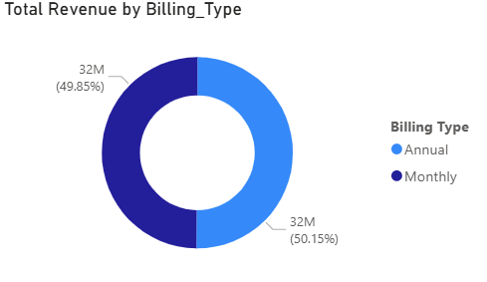
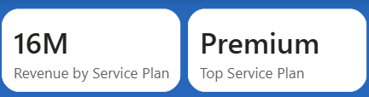
Revenue Consolidation & Performance Overview
Centralized Revenue Visibility
Revenue Consolidation
Total revenue achieved this period shows strong business performance.
Average revenue per invoice indicates healthy transaction value.
Monthly revenue trend reflects consistent customer demand.
Peak revenue months contributed significantly to overall growth.
The Premium Service Plan emerged as the highest revenue-generating offering across all subscription plans
Premium subscriptions contribute a significant share of total business revenue, indicating strong customer preference for high-value

Slide 6
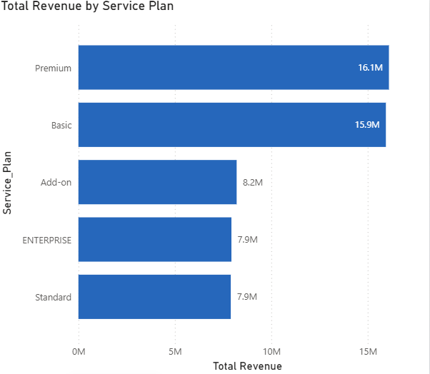
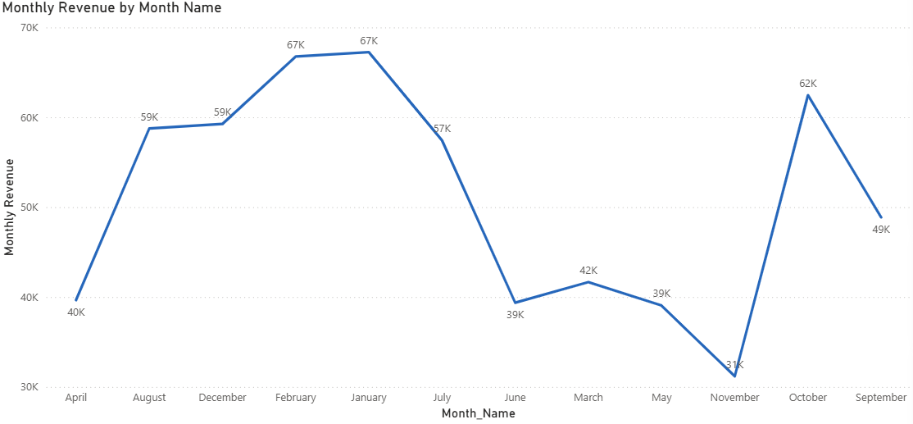
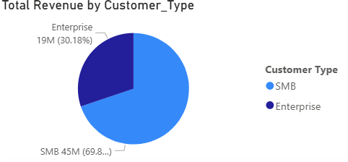

Analytical Approach & KPI Framework
Metrics & Analysis Framework
Defined core KPIs:
Total Revenue
Average Revenue per Invoice
Revenue by Service Plan
Revenue by Customer Type
Monthly Revenue

Slide 7
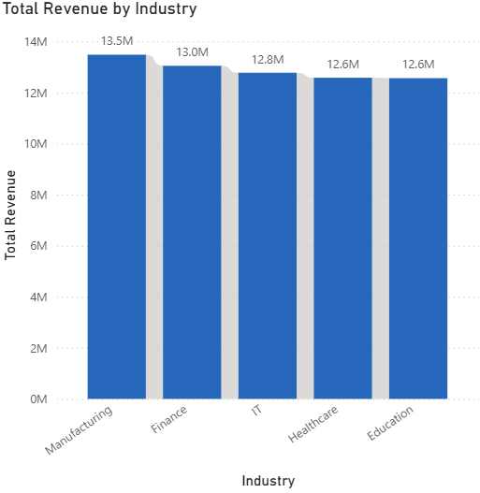
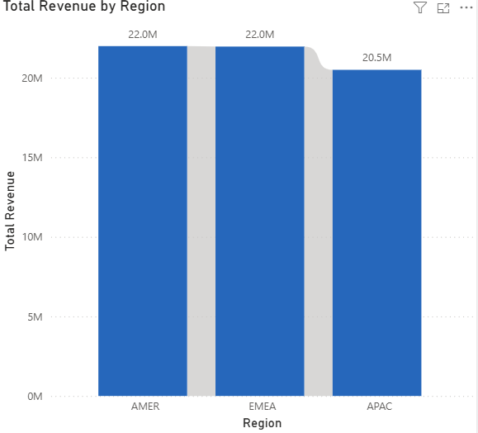
Key Insights & Business Impact
Insights from Dashboard
Regional Revenue Insights
Regional Revenue Insights
Revenue performance varies significantly across regions, highlighting differences in market penetration and customer adoption
Certain regions consistently contribute a higher share of total revenue, making them key focus areas for business expansion
Revenue contribution differs across industries based on subscription demand and service utilization
A few industries account for the majority of revenue, indicating strong product-market alignment within those sectors

